Slide 1
SHG Analysis
Ikhile Peace Osarieme

Slide 2
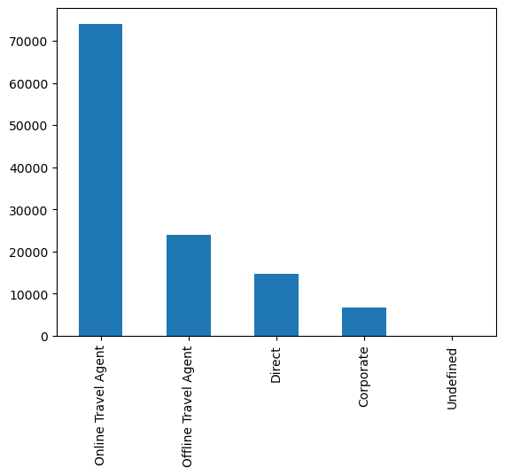
Customer Behaviour Analysis
Based on the analysis, in a span of 3 years, the distribution channel that contributed the most to bookings is the online travel agent with over 70000 booking. Next is the offline travel agent, then direct, and corporate channels.

Slide 3
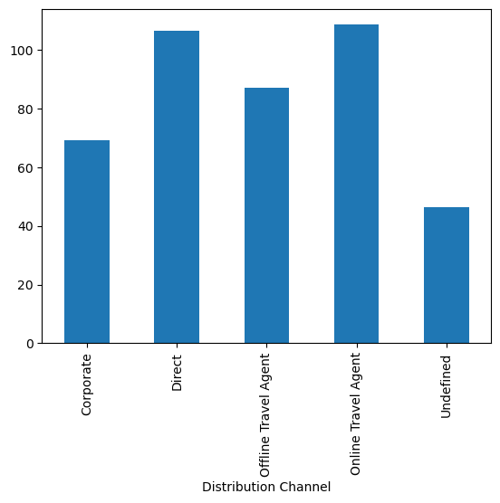
Avg daily rate of distribution channels
Offline travel agent and direct channels have close to the same avg daily rates of the hotels and resorts. They are significantly higher than the other 3 with the least being undefined.
Distribution Channel | Avg Daily Rate
Offline travel agent | 87.145444
Online Travel Agent | 108.567791
Corporate | 69.325204
Direct | 106.654983
Undefined | 46.240000

Slide 4
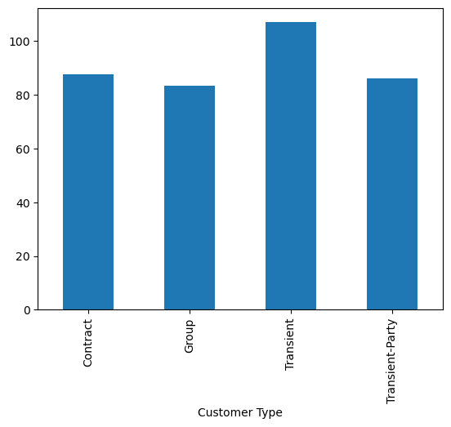
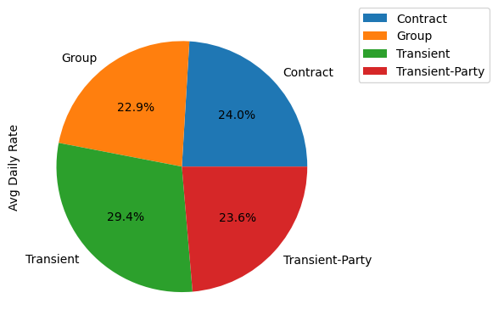
Avg Daily Rate according to Customer Type

Slide 5
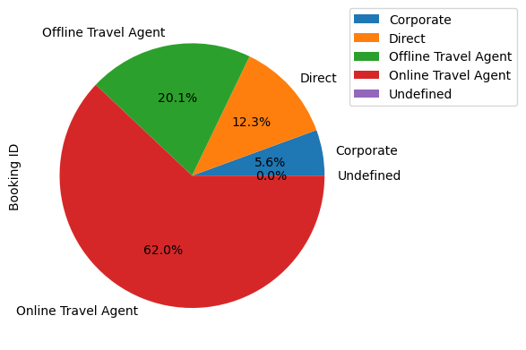
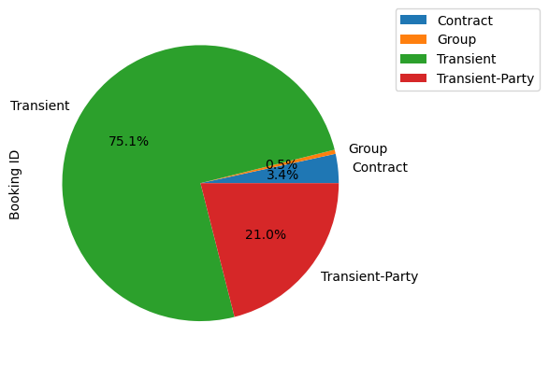
Booking Proportion according to Distribution Channel and Customer Type

Slide 6
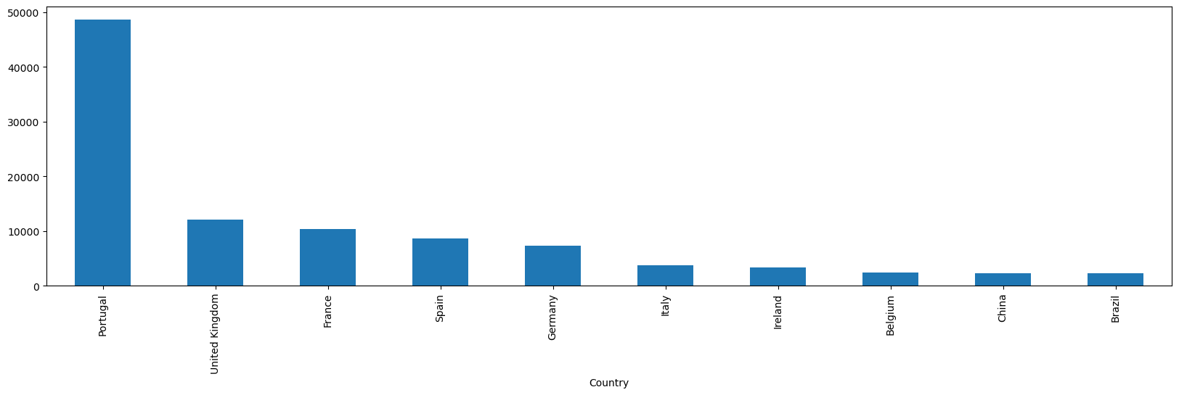
Countries With the Most Bookings
From the values we can see that the top ten countries which have the most bookings are Portugal, UK, France, Spain, Germany, Italy, Ireland, Belgium, China, and Brazil. All these countries are first world countries (countries with well off citizens)

Slide 7
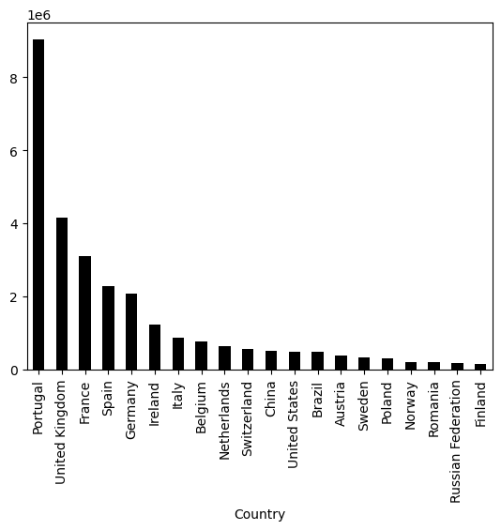
Revenue (Countries generating the most revenue)

Slide 8
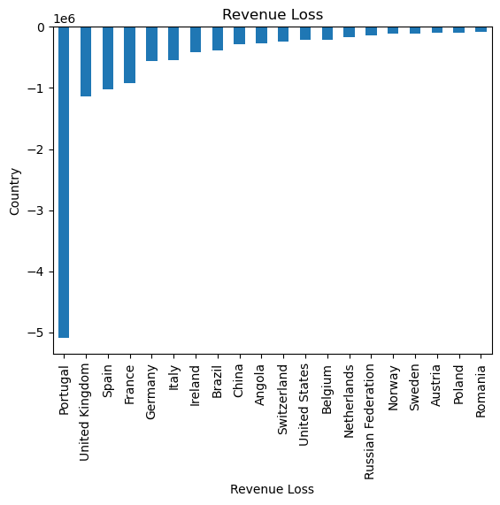
Revenue (Countries with the highest revenue loss)

Slide 9
Leading Variables Correlated to Cancellations
Based on the correlation analysis, the variables which influence the rate of cancellation are namely: lead time, Avg daily rate, guests, and nights.
Cancelled (0/1)
Cancelled (0/1) | 1.000000
status | 0.980601
Lead Time | 0.293123
Avg Daily Rate | 0.047557
Guests | 0.046522
Nights | 0.017779
Booking ID | -0.242238
Revenue | -0.424228
Revenue Loss | -0.517136

Slide 10
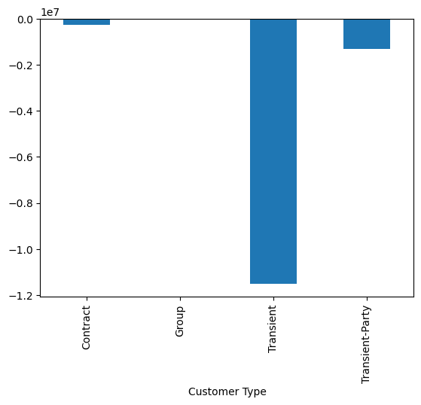
Revenue Loss across Customer Type
Customer Type | Revenue Loss
Contract | -283888.62
Group | -17325.19
Transient | -11502290.03
Transient-Party | -1319396.25

Slide 11
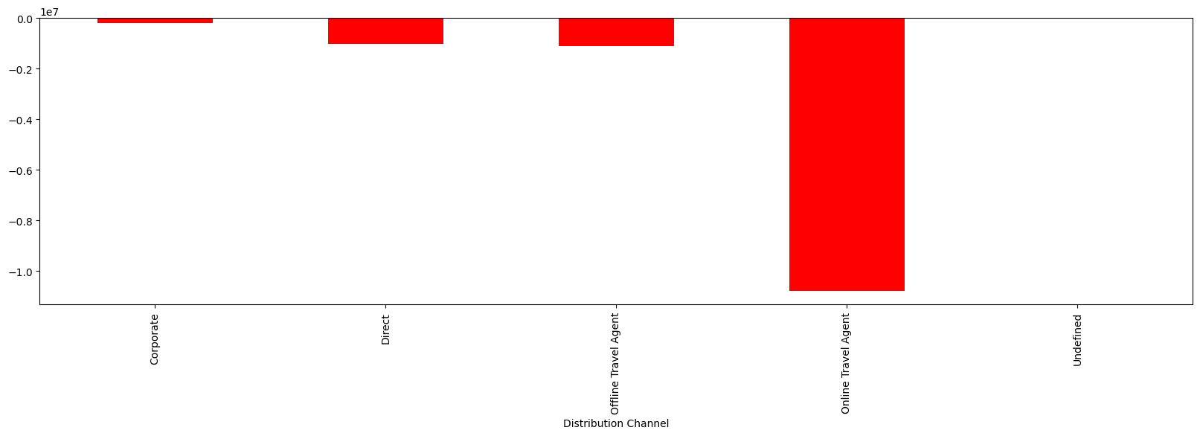
Revenue Loss across Distribution Channel
Channel | Loss
Corporate | -195598.69
Direct | -1033280.81
Offline agent | -1110542.27
Online agent | -10782870.82
undefined | -607.50

Slide 12
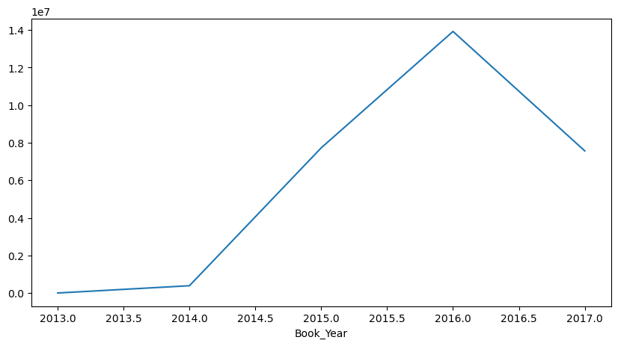
Yearly Revenue Generation

Slide 13
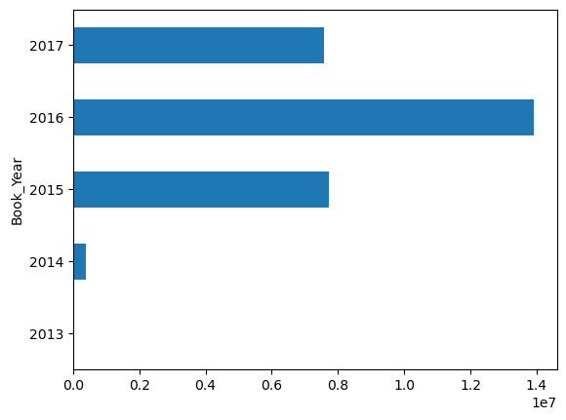
Revenue per Year
Year | Revenue
2013 | 0.0
2014 | 387451.22
2015 | 7727179.52
2016 | 13922674.13
2017 | 7563292.57

Slide 14
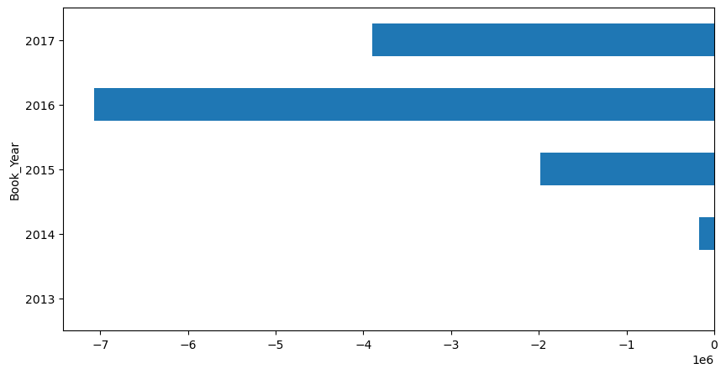
Revenue Loss per Year
Year | Loss
2013 | 0.0
2014 | -167922.26
2015 | -1982860.73
2016 | -7071275.70
2017 | -3900841.40

Slide 15
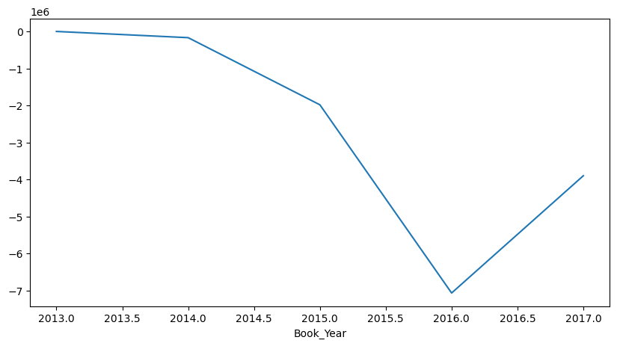
Revenue Loss per Year

Slide 16
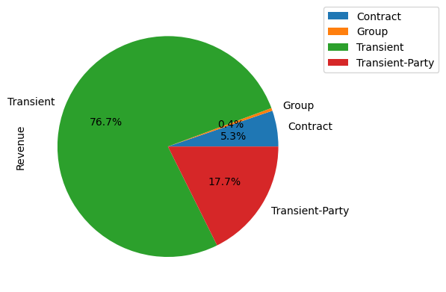
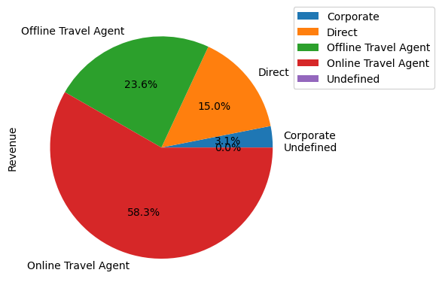
Proportion of Revenue Generated per Customer Type and Distribution Channel

Slide 17
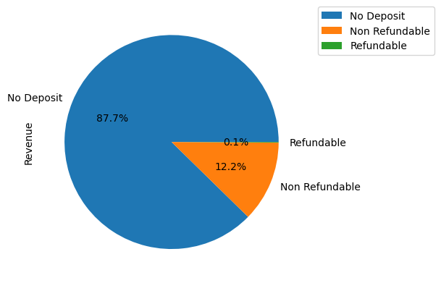
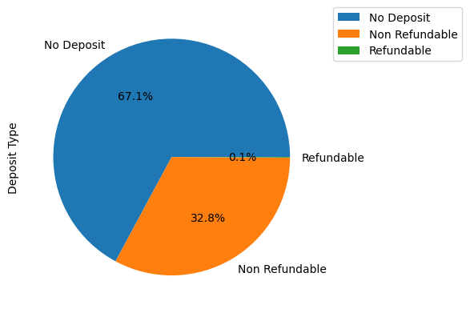
Revenue Generation and Cancellation Proportion according to Deposit Type

Slide 18
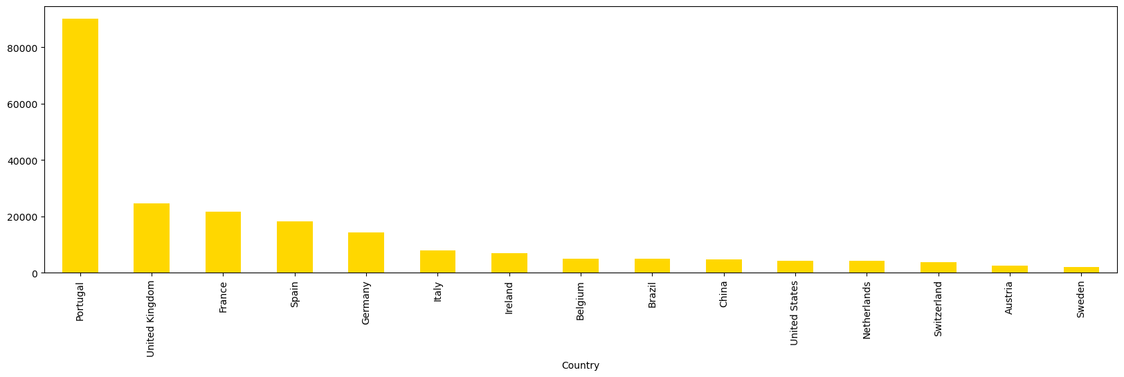
Countries with the Highest Number of Guests

Slide 19
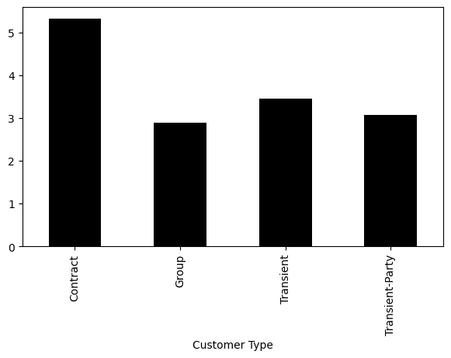
Average Length of Stay according to Customer Type
Customer Type | Average Length of Stay
Contract | 5.3
Group | 2.88
Transient | 3.44
Transient-Party | 3.06

Slide 20
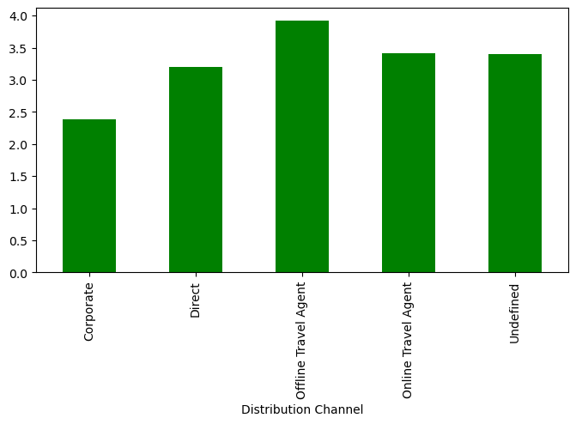
Avg Length of Stay according to Distribution Channel
Channel | Avg Length
Corporate | 2.38
Direct | 3.19
Offline | 3.92
Online | 3.41
Undefined | 3.4

Slide 21
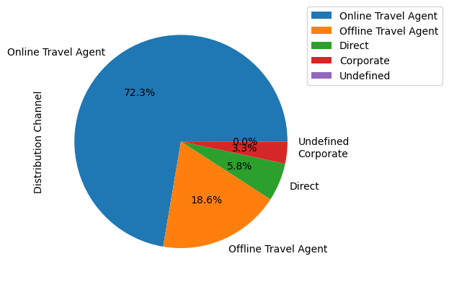
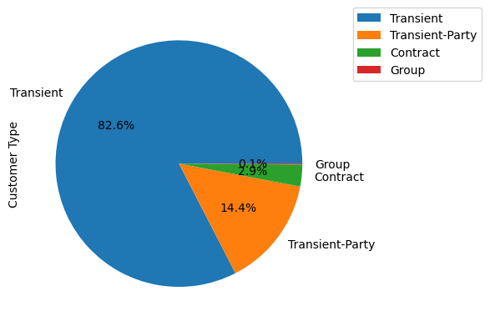
Cancellation Proportion according to Customer Type/ Distribution Channel

Slide 22
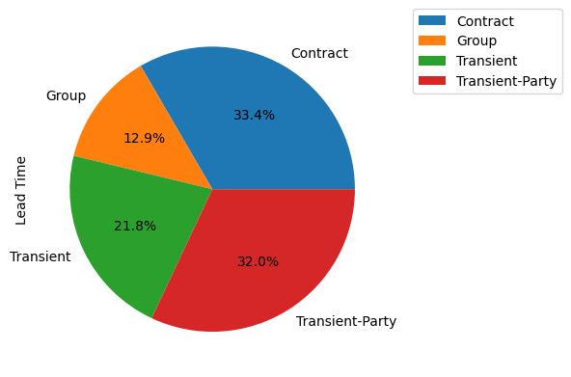
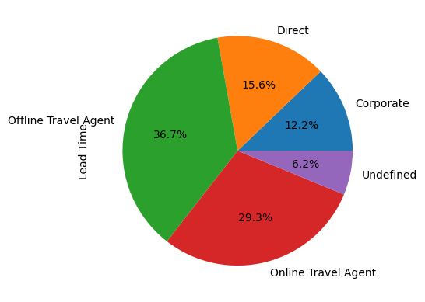
Average Lead Time Variation according to Distribution Channel and Customer Type

